Slide 1
Teaching An Agent To Drive Using IRL and Transfer Learning
By Evan Johnston and Prasanth Suresh

Slide 2


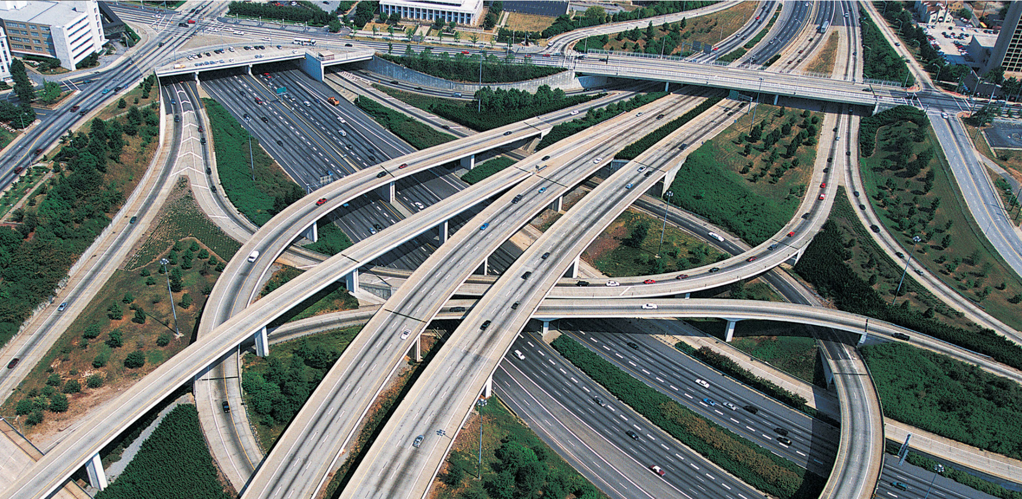
The Motivation

Slide 3
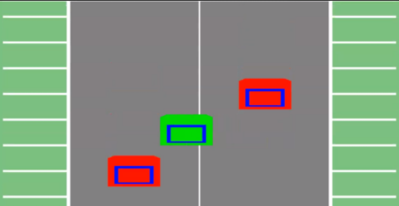
The Highway Problem
The features:
# of lanes
# of “grid” spaces
# of speeds
The actions: left, right, speed up, slow down, no-op
Other settings:
Probability of a car appearing in each lane
Probability of successfully acting (affected by speed)
Driver preferences: slow, maniac, random

Slide 4
But is it really that simple?

Slide 5
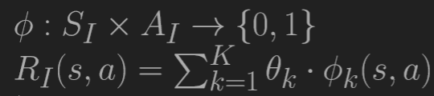
Part 1: Model Free MLE with Q-Averaging
Step 0: Expert uses its policy to generate trajectories X_{n}
Step 1: Expert trajectories, random initial reward weights, zeros Q and dQ table and no transition model, we start.
Step 2: Algorithm begins.
Step 3: Weights returned are converged weights for reward features.
Step 4: For evaluation metrics, these weights and expert’s transition model are sent to policy iteration.

Slide 6
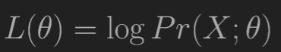
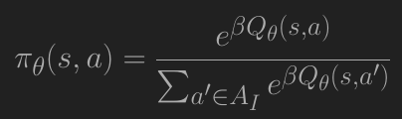
Algorithm:
Compute log likelihood: how well do these rewards explain behavior in trajectories?
Obtain log softmax action probabilities and (state,action) visitation frequency from trajectories.

Slide 7
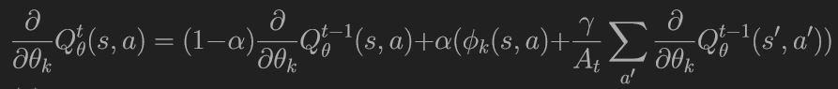
Q update using Q averaging:
Compute dQ:

Slide 8
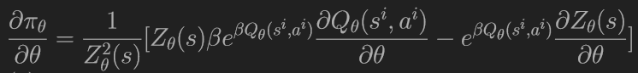
Using softmax policy, dlogπθ(s,a) is computed.
Using -dlogπθ(s,a) and (s,a) visitation frequency, reward gradient is computed.
Multiply freq to corresponding feature of dlogπθ(s,a).
Using Gradient descent of reward gradient, we iterate until:
Delta < eps * (1 - discount) / discount

Slide 9
Reward Features
Collision
Lanes 1 to nLanes
Speeds 1 to nSpeeds.
All boolean features. Feature matrix size nSxnF
State components:
nStates = nSpeeds*nLanes*(nGrids^nLanes)
State ids converted to state components and vice versa

Slide 10
Part 2: Transfer Learning
What can be different?
The action space
The reward function
The start state
The goal state
The transition function
What can be transferred?
The policy
The reward
The value function
(And much more!)

Slide 11
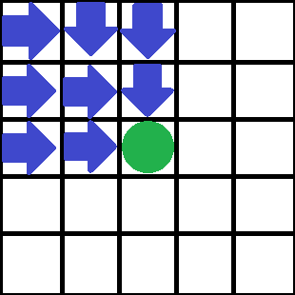
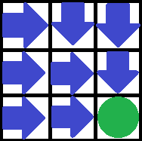
An Example

Slide 12
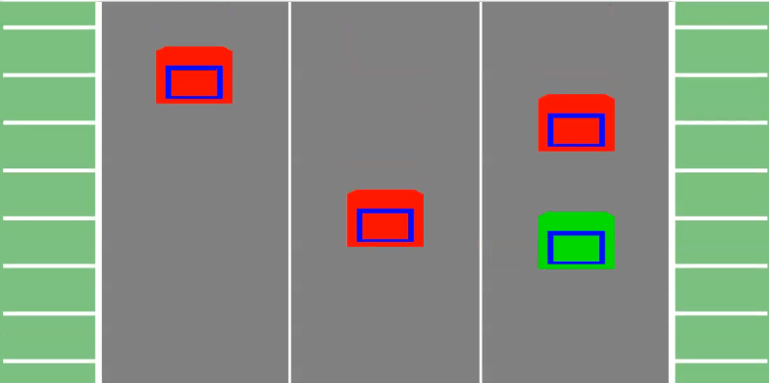
What did we transfer?
The policy and the value function
2 speeds, 2 lanes, 8 grids (256) -> 2 speeds, 3 lanes, 8 grids (3072)
Notes:
State space is number of speeds * number of lanes * number of grids ^ number of lanes; 256 for small, 3072 for large

Slide 13
Experiments:
Using 5 trajectories, 10 steps, Model-Free MLE was used to obtain reward weights.
Done for Safe and Erratic driving behaviors.
Using 2 lane 2 speed 8 Grid Highway domain.
Inverse Learning Error and Learned Behavior Accuracy were obtained.
Transition model was modified and a policy was generated.
Saved parameters were transferred over for transfer learning to learn.

Slide 14


Slide 15
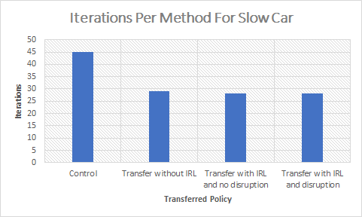
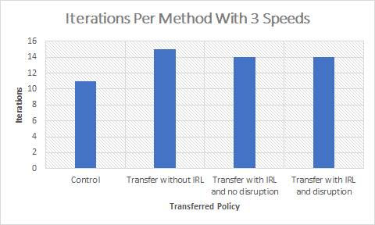

How Long Did It Take?
Notes:
Iterations took an average of 50 seconds

Slide 16
Conclusion:
Targets reached:
Model Free MLE.
Policy with modified transitions.
Transfer learning.
Learning from scratch vs learning using smaller problem.
Discussion:
Using learned weights but modified transitions.
Transfer learning worked as intended.

Slide 17
Questions?

